Slide 1
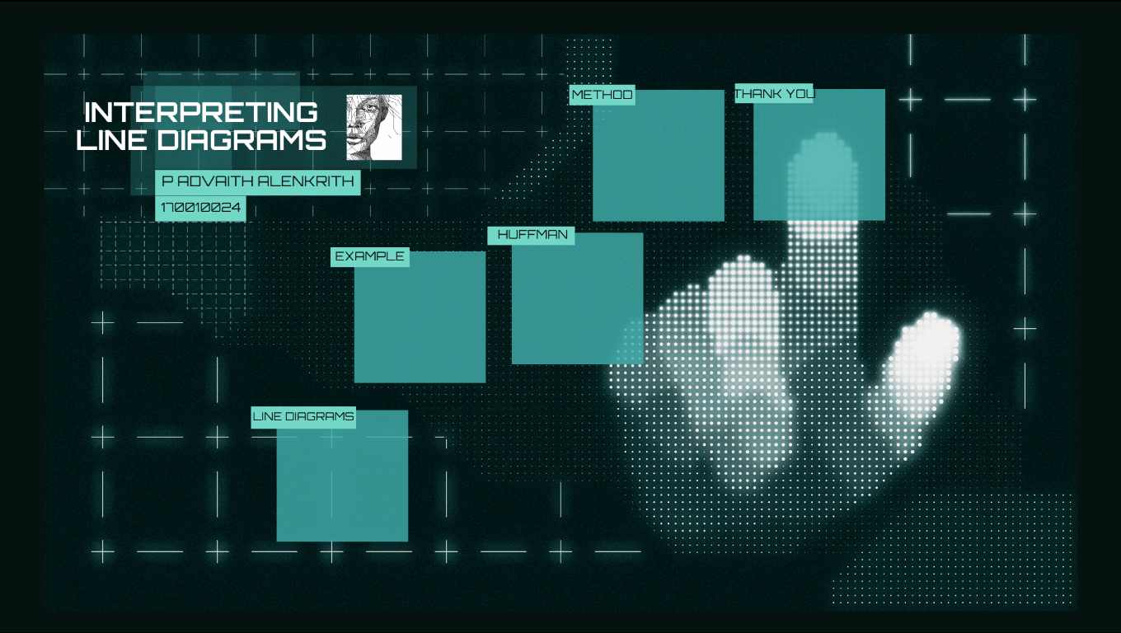

Slide 2
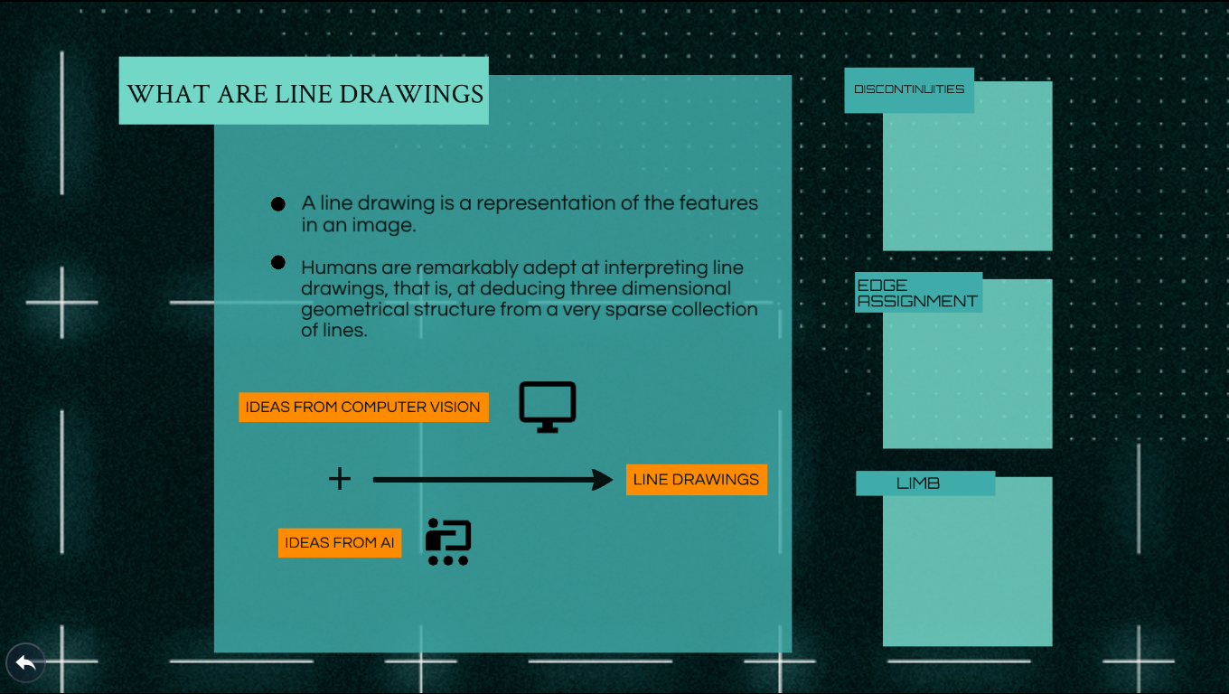

Slide 3
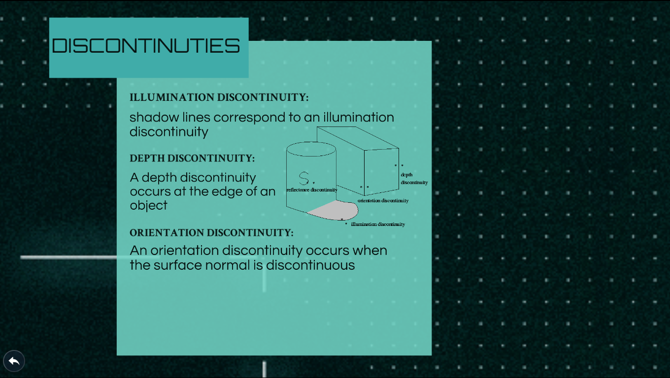

Slide 4
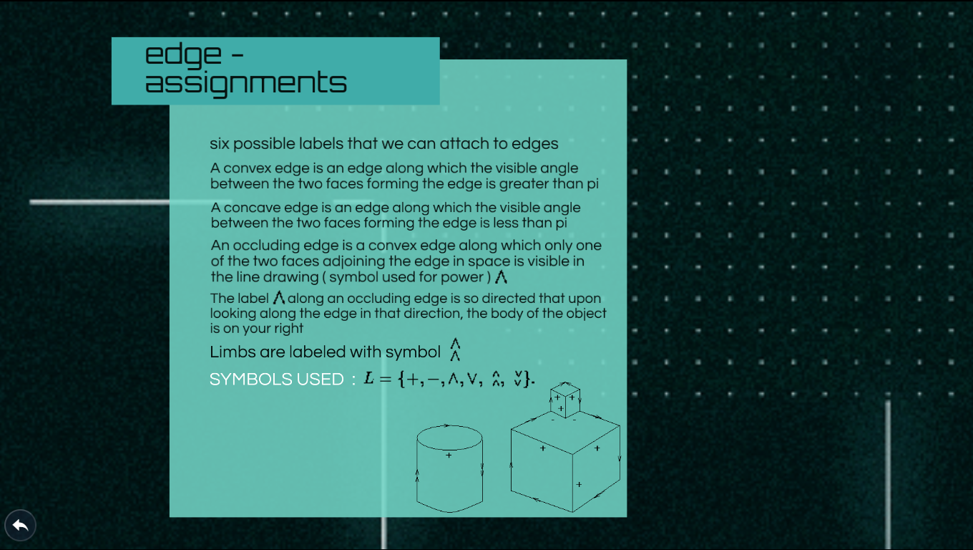

Slide 5
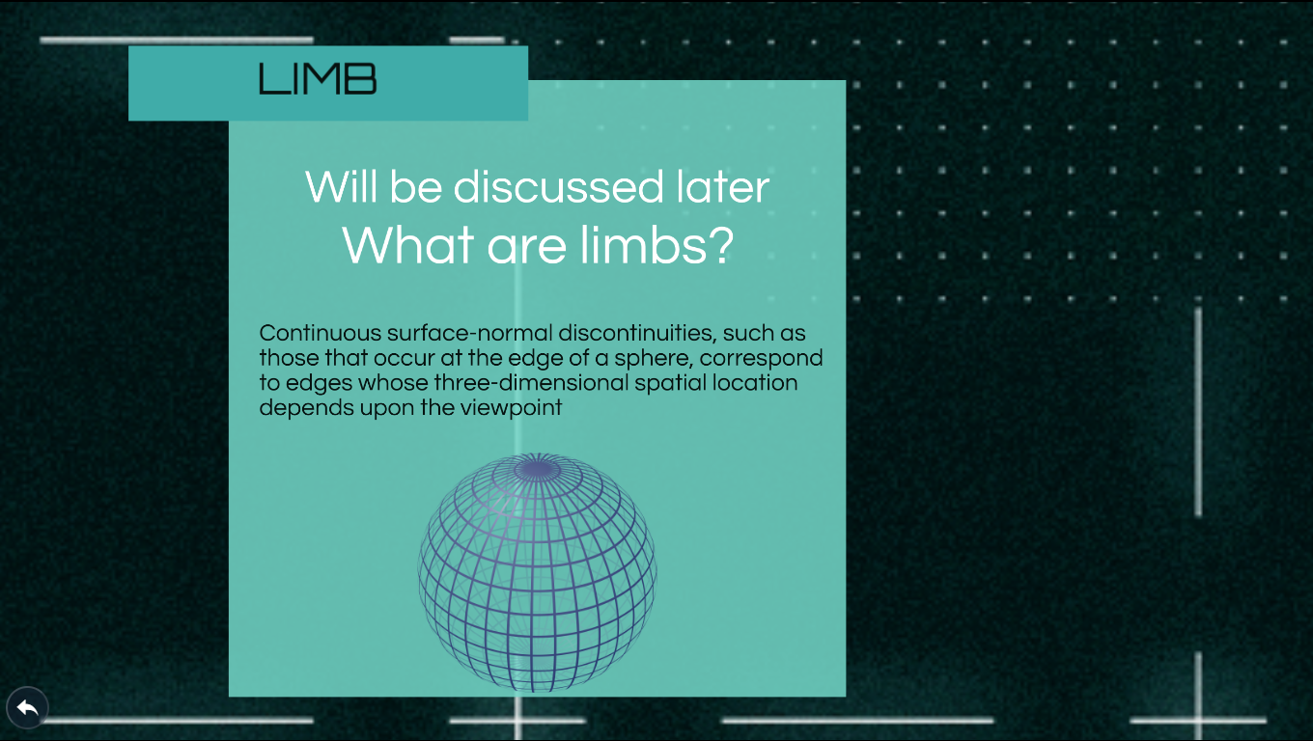

Slide 6
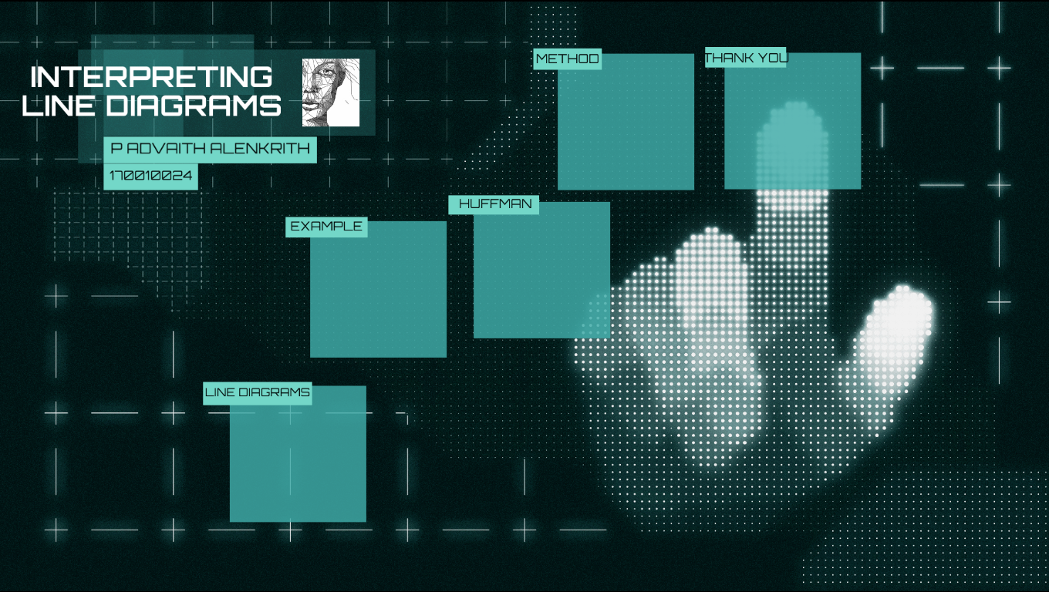

Slide 7
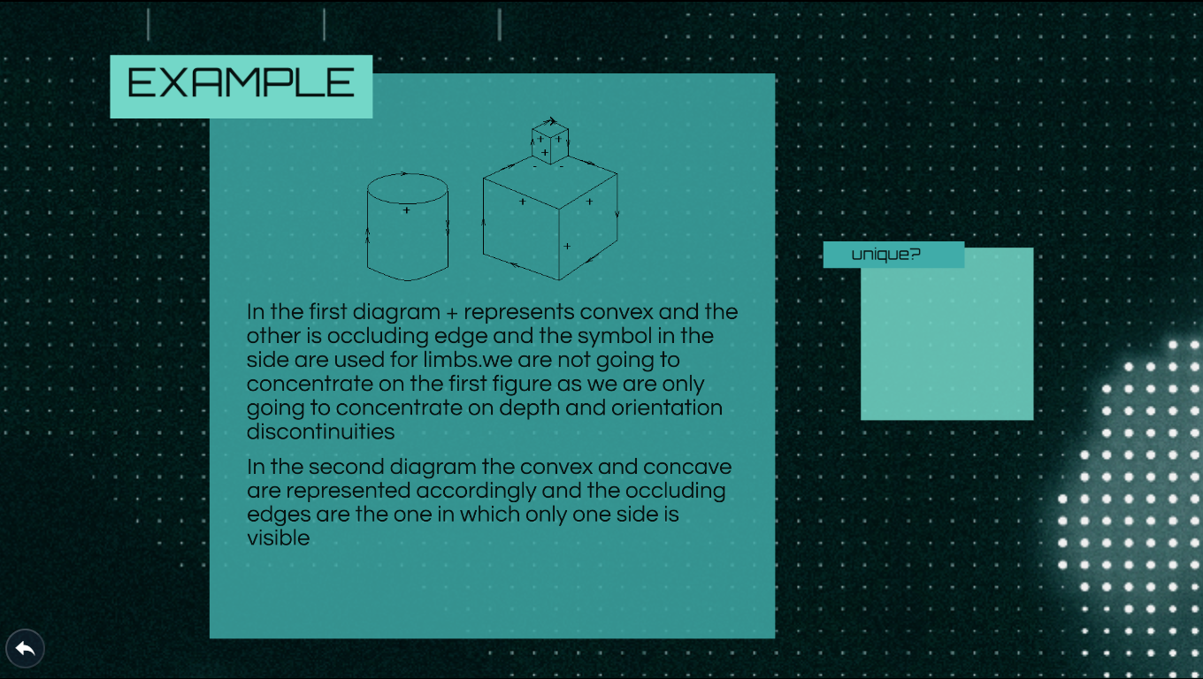

Slide 8
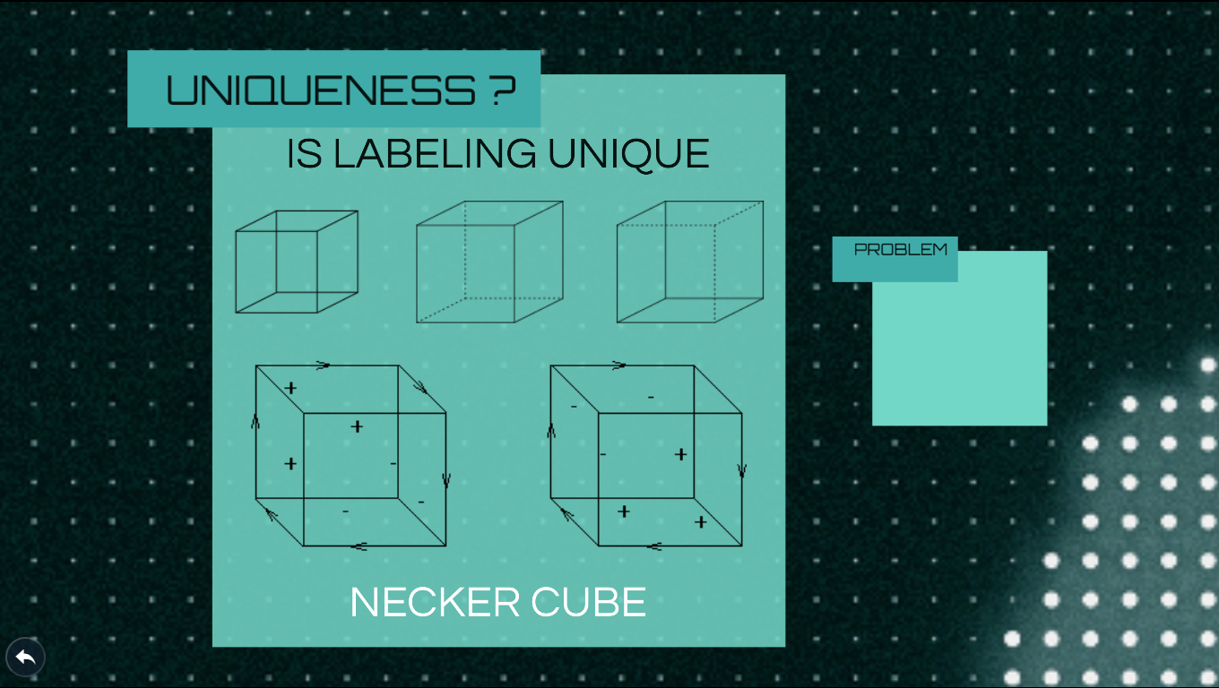

Slide 9
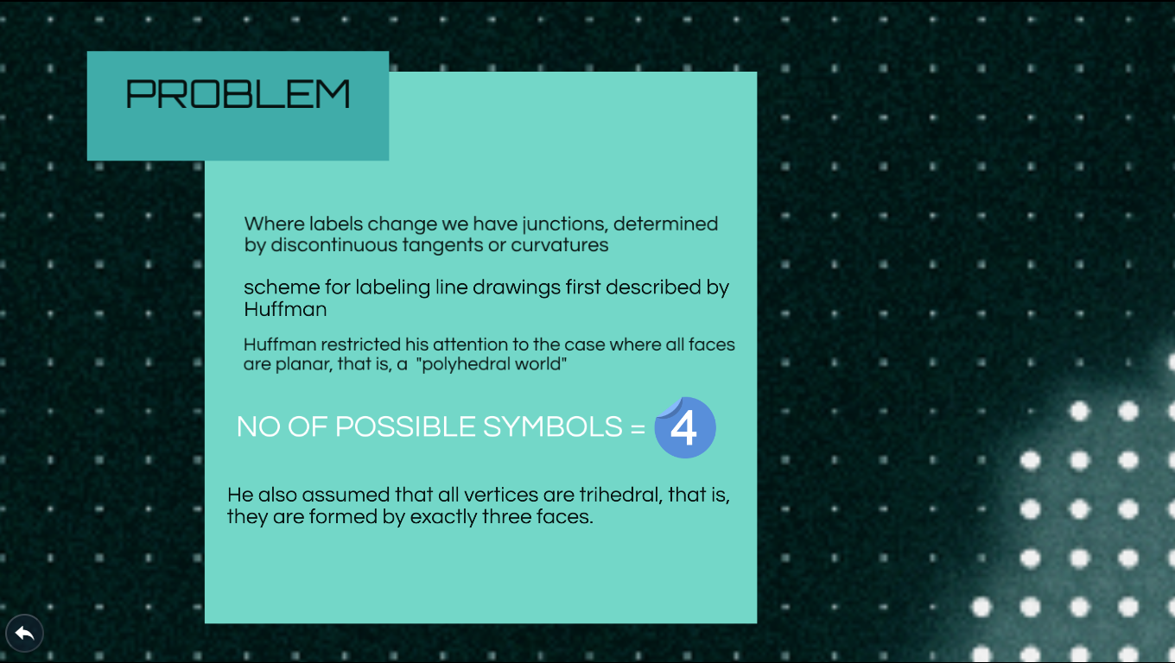

Slide 11
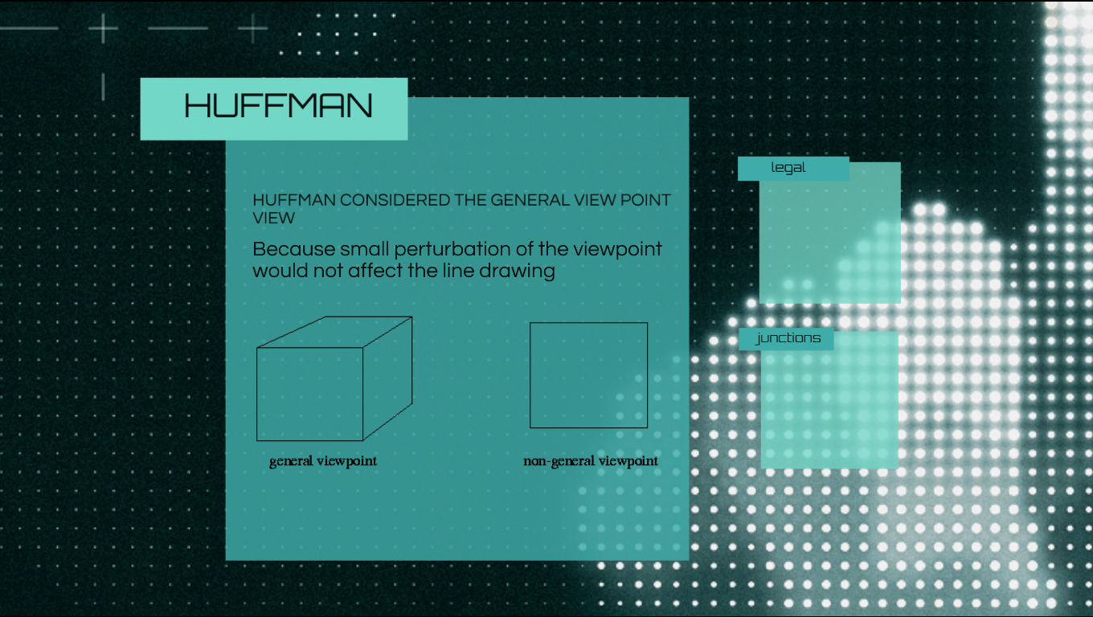

Slide 12
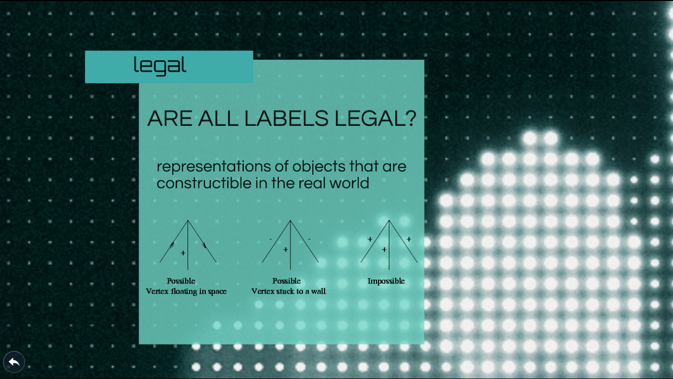

Slide 13
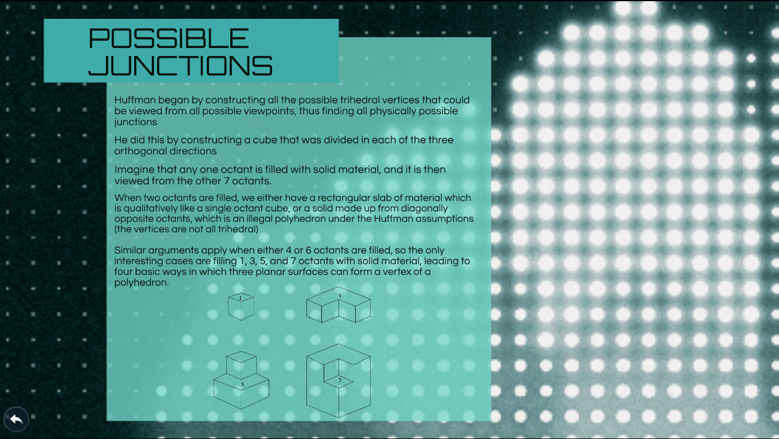

Slide 15
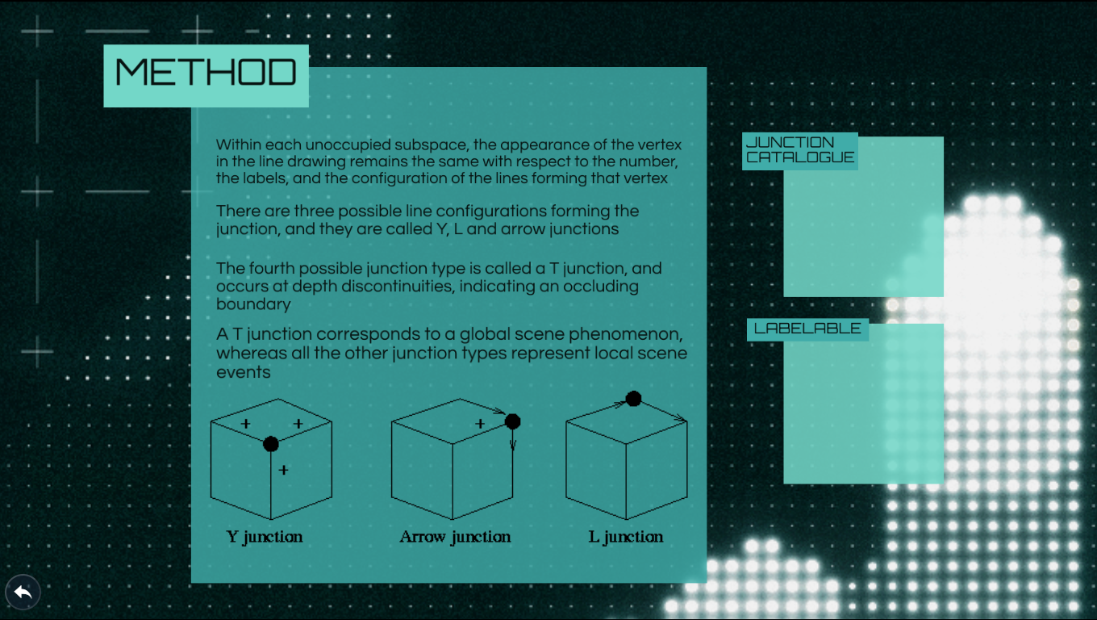

Slide 16
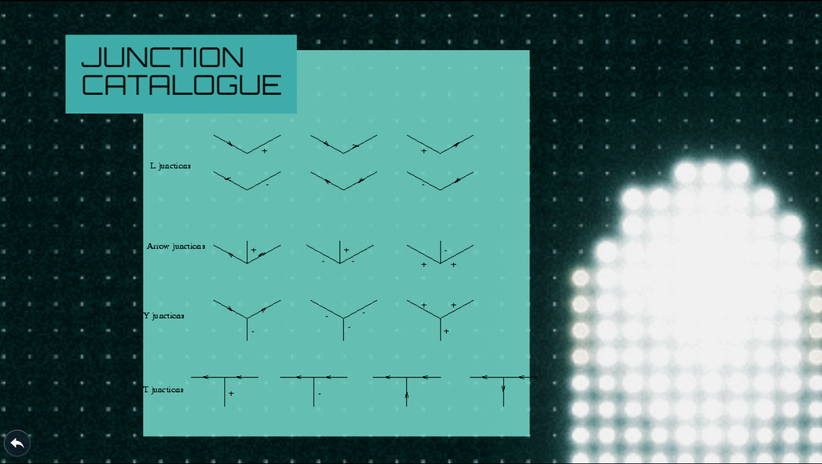

Slide 17
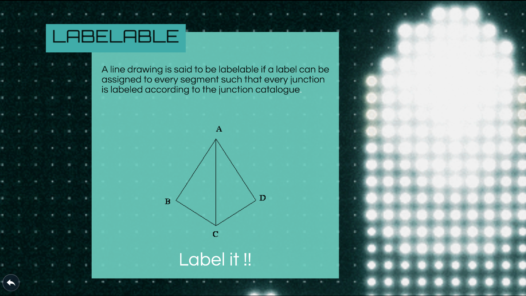

Slide 19
CONSTRAINT SATISFACTION – WALTZ ALGORIHTM
Many perceptual tasks appear to be highly complex . this is because the number of interpretations that can be assigned to individual components of an input is large and the number of combinations of those components also appears to be enormous. But a clear analysis well reveal that many do the combinations can not actually occur. These natural constraints can be exploited in the understanding process to reduce the complexity from unmanageable to manageable.
The Waltz algorithm is for interpreting line drawings of solid polyhedral.

Slide 20
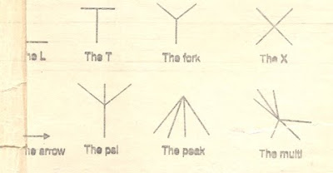
There are two important steps in the use of constraints in problem solving:
1. Analyze the problem domain to determine the actual constraints.
2. Solve the problem by applying a constraint satisfaction algorithm.
Consider for example a three dimensional line drawing . The analysis process is to determine the object described by the lines. The geometric relationships between different types of line junctions helped to determine the object types.

Slide 21
In waltz’s algorithm, labels are assigned to lines of various types-say concave edges are produced by two adjacent touching surfaces which duce a concave (less than 180 Degrees) depth change .
Conversely, convex edges produce a convexly viewed depth (greater than 180 degrees), and a boundary edge outlines a surface that obstracts other objects.

Slide 22
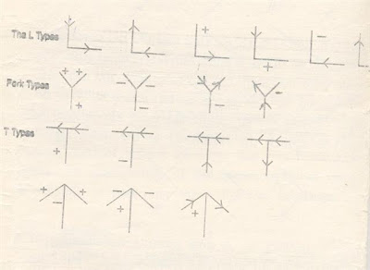
To label a concave edge, a mints sign is used. Convex edges one labeled with a plus sign, and a right or left arrow is used to label the boundary edges. By restricting vertices to be the intersection of three object faces, it is possible to reduce the number of basic vertex types to only four : the L, the T , the Fork and the Arrow.

Slide 23
When a three-dimensional object is viewed from all possible positions, the four junction types, together with the valid edge labels, give rise to eighteen different permissible junction configurations as shown in figurre
Geometric constraints, together with a consistent labeling scheme, can simplify the object identification process. A set of labeling rules which facilitates this process can be developed for different classes of objects. The following rules will apply for many polyhedral objects.

Slide 24
1. The arrow should be directed to mark boundaries by traversing the object in a clockwise direction.
2. Unbroken lines should have the same lable assigned at both ends.
3. When a fork is labeled with a+ edge, it must have all three edges label as + , and
4. Arrow junctions which have an arrow label on both bard edges must also have a + label on the shaft.
These rules can be applied to a polygonal object as given in figure

Slide 25
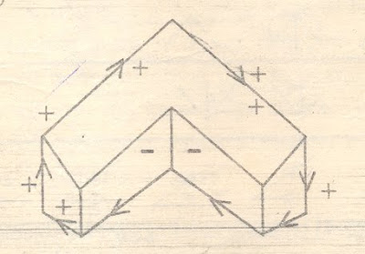
example of object labelling.
Starting with any edge having an object face on its right, the external boundary is labelled with the arrow in a clockwise direction. Interior lines are then labelled with + or _ consistent with the other labelling rules.

Slide 26
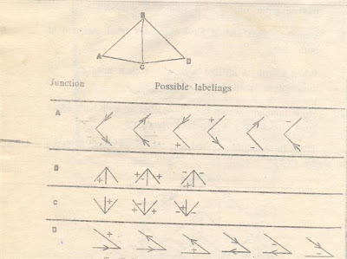
To see how waltz constraint satisfaction algorithm works, consider the image drawing of a pyramid as given in figure At the right side of the pyramid are all possible labelings for the four junctions A, B, C and D.

Slide 27
Using these labels as mutual constraints on connected junctions, permissible labels for the whole pyramid can be determined. The constraint satisfaction procedure works as follows.
Starting at an arbitrary junction, say A, a record of all permissible labels is made for that junction. An adjacent junction is then chosen, say , B and labels which are inconsistent with the line AB are then eliminated from the p

Slide 28
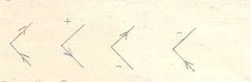
permissible A and B lists. In this case, the line joining B can only be a +, - or an up arrow consequently, two of the possible A labelings can be eliminated and the remaining are
Choosing junction c next, we find that the BC constraints are

Slide 29
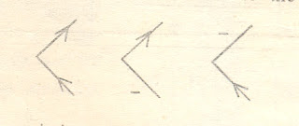
satisfied by all of the B and C labelling, so on reduction
is possible with this step. On the otherhand, the line AC must be labled as – or as an up-left-arrow to be consistent. Therefore, an additional label for A can be eliminated to reduce the remainder to the following.

Slide 30
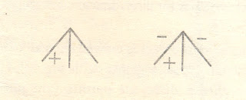
This new restriction on a now permit the elimination of one B labelling to maintain consistency. Thus, the permissible B labelling remaining are now

Slide 31
This reduction in turn, places a new restriction on BC, permitting the elimination of one C label, since BC must now be labelled as a + only. This leaves the remaining C labels as show in side diagram. 4. Moving now to junction d, we see that of the six possible D leadings, only three satisfy the BD constraint of a up or a down arrow. Therefore, the remaining permissible leavenings for d are now

Slide 32
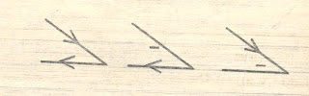
Continuing with the above procedure, we see that further label eliminations are not possible since all constraints have been satisfied. This process is completed by finding the different combinations of unique labelling that can be assigned to the figure. An enumerations of the remaining label shows that its is possible to find only three different labelling.

Slide 33
QUICK REVIEW
Formal Constraint Satisfaction Problem A CSP is a triplet { V , D , C }.
A CSP has a finite set of variables V = { V1 , V2 .. VN }.
Each variable may be assigned a value from a domain D of values.
C are binary constraints. Each member of C is a pair. The first member of each pair is a set of variables. The second element is a set of legal values which that set may take.
Example: V = { V1 , V2 , V3 , V4 , V5 , V6 } D = { R , G , B } C = { (V1,V2) : { (R,G), (R,B), (G,R), (G,B), (B,R) (B,G)}, { (V1,V3) : { (R,G), (R,B), (G,R), (G,B), (B,R) (B,G)}, ……….: : }

Slide 34
VALID LABLES

Slide 35
EXAMPLE: SCENE ANALYSIS FOR POLYHEDRA

Slide 36
LINE CLASSES
>
Boundaries
-
Real
edges
>
-
>
Concave
-
Interiors
>
-
+
>
All lines
>
Convex
Shadows
Pseudo
edges
c
>
Cracks
c
>
>
>
+
+
>
>
+
>
>

Slide 37
COMMON JUNCTIONS
L
Psi
Arrow
X
Trihedral vertices
K
Fork
Peak
T
Ka

Slide 38
COMBINATORICS: SIMPLE CASE
Trihedral vertices, no concave or crack edges, uniform illumination (no shadows)
4 ways to label a line, so
4² = 16 labelings for an L
4³ = 64 labelings for fork, arrow, and T
BUT out of 208 junctions, only 18 are physically possible
Still, savings don’t look that big...

Slide 39
COMBINATORICS: NO ASSUMPTIONS
Vertex Approximate # Approximate #
type possible labelings physical labelings
L 2.50x10³
Fork 1.25x10⁵
T 1.25x10⁵
Arrow 1.25x10⁵
Psi 6.25x106
K 6.25x10⁶
X 6.25x10⁶
Multi 6.25x10⁶
Peak 6.25x10⁶
Ka 3.12x10⁸
80
500
500
70
300
100
100
100
10
30

Slide 40
WALTZ’S ALGORITHM
1. Find borders and label them: border has no vertices outside it.
2. Number vertices to be traversed in order:
a. Number boundary vertices first.
b. Number interior vertices by moving from a numbered vertex
toward an adjacent unnumbered one.
3. Now visit each vertex V in order and attempt to label:
a. Attach all physically possible labels of type V.
b. For each vertex A adjacent to V and already visited, eliminate
from V any labeling for which there is no consistent label at A.
c. For each vertex adjacent to A visited in step b, do:
i. Eliminate labels inconsistent with V.
ii.If any eliminated, propagate constraints to neighbors of A.
iii. Continue to propagate until there are no adjacent
labeled vertices or no change made to a set.

Slide 41
SIMPLEST EXAMPLE (TRIHEDRAL)
B
A
C
B
A
F
G
D
C
E
D
G
E
F
A: ((< <) (> >) (> +) (+ <) (> -)(- <)) 6 Ls
F: ((-+-)….(+++)…(<-<)...) 3 Arrows, 4 Forks, 4 Ts

Slide 42
CONSTRAINTS FOR A
B
C
Before:
A
A: ((< <)(> >)(> +) (+ >)(< -)(->))
B: ((- + -) (> + >) (+ - +)
(+ + +)(- - - )(- < <)(> - >)(< < -)
(< - <)(< + <)(< > <)(< < <))
D
G
F: ((- + -) (> + >) (+ - +)
(+ + +)(- - - )(- < <)(> - >)(< < -)
(< - <)(< + <)(< > <)(< < <))
E
F
After:
A: ((> >))

Slide 43
CONSTRAINTS FOR B
B
C
Before:
A
B: ((- + -) (> + >) (+ - +)
(+ + +)(- - - )(- < <)(> - >)(< < -)
(< - <)(< + <)(< > <)(< < <))
D
A: ((> >))
G
G: ((- + -) (> + >) (+ - +)
(+ + +)(- - - )(- < <)(> - >)(< < -)
(< - <)(< + <)(< > <)(< < <))
E
F
After:
B: ((> + >) (> - >))
Backup to A produces no changes.

Slide 44
CONSTRAINTS FOR C
B
C
Before:
A
C: ((< <)(> >)(> +) (+ >)(< -)(->))
D
B: ((> + >) (> - >))
D: ((- + -) (> + >) (+ - +)
(+ + +)(- - - )(- < <)(> - >)(< < -)
(< - <)(< + <)(< > <)(< < <))
G
E
F
After:
C: ((> >))
Backup to B produces no changes.

Slide 45
…WHEN YOU’RE DONE...
A
B
B
C
A
A: ((> >))
B: ((> + >)(> - >))
C: ((> >))
D: ((> + >)(> - >))
E: ((> >))
F: ((> + >) (> - >))
G: ((+ + +) (- - -))
F
G
D
G
C
E
D
E
F

Slide 46
WALTZ’S ALGORITHM FACTOIDS
Guaranteed to find unique correct figure labeling if one exists.
If more than one labeling exists, at least one vertex set will have multiple entries; by doing a depth-first exhaustive traversal of the graph you can generate all possible labelings.
Illumination serves to reduce ambiguity.

Slide 47
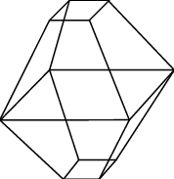
QUESTIONS
Q1 LABEL THE FOLLOWING 3D OBJECTS :
Q2 HOW CAN YOU LABEL COMPLEX OBJECTS LIKE A MOUSE
Q3 IS IT NECESSARY THAT ALL LABELABLE OBJECT CAN BE CONSTRUCTED IN THE REAL WORLD

